Slide 1
PROCESS-TO-PROCESS DELIVERY
The transport layer is responsible for process-to-process delivery—the delivery of a packet, part of a message, from one process to another. Two processes communicate in a client/server relationship, as we will see later.

Slide 2

Note
The transport layer is responsible for process-to-process delivery.

Slide 3

Figure 23.1 Types of data deliveries

Slide 4
Client, server
1. Local host
2. Local process
3. Remote host
4. Remote process

Slide 5
lANA Ranges
The lANA (Internet Assigned Number Authority) has divided the port numbers into
three ranges: well known, registered, and dynamic (or private) Well-known ports.
The ports ranging from 0 to 1023 are assigned and controlled by lANA. These are the well-known ports.
Registered ports. The ports ranging from 1024 to 49,151 are not assigned or controlled by lANA.
Dynamic ports. The ports ranging from 49,152 to 65,535 are neither controlled nor registered. They can be used by any process. These are the ephemeral ports

Slide 6
Serial No. | IP address | Port Number
01. | Internet Protocol address (IP address) used to identify a host in network. | Port number is used to identify an processes/services on your system
02. | IPv4 is of 32 bits (4 bytes) size and for IPv6 is 128 bits (16 bytes). | The Port number is 16 bits numbers.
03. | IP address is the address of the layer-3 IP protocol. | Port number is the address of the layer-4 protocols.
04. | IP address is provided by admin of system or network administrator. | Port number for application is provided by kernel of Operating System.
05. | ipconfig command can be used to find IP address . | netstat command can be used to find Network Statistics Including Available TCP Ports.
06. | IP address identify a host/computer on a computer network. | Port numbers are logical interfaces used by communication protocols.
07. | 192.168.0.2, 172.16.0.2 are some of IP address examples. | 80 for HTTP, 123 for NTP, 67 and 68 for DHCP traffic, 22 for SSH etc.

Slide 7
Figure 23.2 Port numbers
Port Number | Service name | Transport protocol | Description
7 | Echo | TCP, UDP | Echo service
20 | FTP-data | TCP, SCTP | File Transfer Protocol data transfer
21 | FTP | TCP, UDP, SCTP | File Transfer Protocol (FTP) control connection
22 | SSH-SCP | TCP, UDP, SCTP | Secure Shell, secure logins, file transfers (scp, sftp), and port forwarding
23 | Telnet | TCP | Telnet protocol—unencrypted text communications
25 | SMTP | TCP | Simple Mail Transfer Protocol, used for email routing between mail servers
53 | DNS | TCP, UDP | Domain Name System name resolver
69 | TFTP | UDP | Trivial File Transfer Protocol
80 | HTTP | TCP, UDP, SCTP | Hypertext Transfer Protocol (HTTP) uses TCP in versions 1.x and 2. HTTP/3 uses QUIC, a transport protocol on top of UDP
88 | Kerberos | TCP, UDP | Network authentication system
102 | Iso-tsap | TCP | ISO Transport Service Access Point (TSAP) Class 0 protocol
110 | POP3 | TCP | Post Office Protocol, version 3 (POP3)
135 | Microsoft EPMAP | TCP, UDP | Microsoft EPMAP (End Point Mapper), also known as DCE/RPC Locator service, used to remotely manage services including DHCP server, DNS server, and WINS. Also used by DCOM
137 | NetBIOS-ns | TCP, UDP | NetBIOS Name Service, used for name registration and resolution
139 | NetBIOS-ssn | TCP, UDP | NetBIOS Session Service
143 | IMAP4 | TCP, UDP | Internet Message Access Protocol (IMAP), management of electronic mail messages on a server
381 | HP Openview | TCP, UDP | HP data alarm manager
383 | HP Openview | TCP, UDP | HP performance data collector.
443 | HTTP over SSL | TCP, UDP, SCTP | Hypertext Transfer Protocol Secure (HTTPS) uses TCP in versions 1.x and 2. HTTP/3 uses QUIC, a transport protocol on top of UDP.
464 | Kerberos | TCP, UDP | Kerberos Change/Set password
465 | SMTP over TLS/SSL, SSM | TCP | Authenticated SMTP over TLS/SSL (SMTPS), URL Rendezvous Directory for SSM (Cisco protocol)
587 | SMTP | TCP | Email message submission

Slide 8

Figure 23.2 Port numbers

Slide 9

Figure 23.3 IP addresses versus port numbers

Slide 10

Figure 23.4 IANA ranges
Notes:
IANA, the Internet Assigned Numbers Authority, is an administrative function of the Internet that keeps track of IP addresses, domain names, and protocol parameter identifiers that are used by Internet standards.
Port 20 and 21: FTP data and FTP control, respectively
■Port 22: Remote login protocol secure shell (SSH)
■Port 23: Telnet, used for accessing system remotely but is not very secure
■Port 25: Simple Mail Transfer Protocol (SMTP) used by e-mail servers
■Port 53: DNS protocol
■Port 80: Used for accessing Web servers
OpenVPN, port 1194
Microsoft SQL Server, port 1433
Point-to-Point Tunneling Protocol, port 1723

Slide 11

Figure 23.5 Socket address

Slide 12

Figure 23.6 Multiplexing and demultiplexing

Slide 13
Connectionless Versus Connection-Oriented Service
Connectionless Service
In a connectionless service, the packets are sent from one party to another with no need for connection establishment or connection release. The packets are not numbered; they may be delayed or lost or may arrive out of sequence. There is no acknowledgment either. We will see shortly that one of the transport layer protocols in the Internet model, UDP, is connectionless.
Connection-Oriented Service
In a connection-oriented service, a connection is first established between the sender and the receiver. Data are transferred. At the end, the connection is released. TCP and SCTP are connection-oriented protocols.

Slide 14
Reliable Versus Unreliable
The transport layer service can be reliable or unreliable. If the application layer program needs reliability, we use a reliable transport layer protocol by implementing flow and error control at the transport layer. This means a slower and more complex service.
On the other hand, if the application program does not need reliability because it uses its own flow and error control mechanism or it needs fast service or the nature of the service does not demand flow and error control (real-time applications), then an unreliable protocol can be used.
UDP is connectionless and unreliable; TCP and SCTP are connection oriented and reliable.
These three can respond to the demands of the application layer programs.

Slide 15

Figure 23.7 Error control

Slide 16

Figure 23.8 Position of UDP, TCP, and SCTP in TCP/IP suite
Notes:
SCTP stands for Stream Control Transmission Protocol. It is a connection- oriented protocol.

Slide 17
USER DATAGRAM PROTOCOL (UDP)
The User Datagram Protocol (UDP) is called a connectionless, unreliable transport protocol. It does not add anything to the services of IP except to provide process-to-process communication instead of host-to-host communication.

Slide 18

Figure 23.9 User datagram format

Slide 19
Note
UDP length
= IP length – IP header’s length

Slide 20

Figure 23.10 Pseudoheader for checksum calculation

Slide 21
Example 23.2
Figure 23.11 shows the checksum calculation for a very small user datagram with only 7 bytes of data. Because the number of bytes of data is odd, padding is added for checksum calculation. The pseudoheader as well as the padding will be dropped when the user datagram is delivered to IP.

Slide 22

Figure 23.11 Checksum calculation of a simple UDP user datagram
Notes:
ASCII value of uppercase alphabets – 65 to 90. ASCII value of lowercase alphabets – 97 to 122.

Slide 23
UDP Operation
Connectionless service- no relation between datagram, not numbered
No Flow and error control- no flow control so no window mechanics.
No error control except checksum (silently discard packet)
Encapsulation and decapsulation – IP Datagrams

Slide 24
Example 23.2.3
A UDP header in hexadecimal format
06 32 00 0D 00 1C E2 17
What is the source port number?
What is the destination port number?
What is the total length of the user datagram?
What is the length of the data?
Notes:
Source Port –
Source Port is 2 Byte long field used to identify the port number of the source. The source port number is the first four hexadecimal digits i.e. 06 32 if we convert hexadecimal to decimal we get 1586.
Destination Port –
It is a 2 Byte long field, used to identify the port of the destined packet. The destination port number is the second four hexadecimal digits 00 0D if we convert hexadecimal to decimal we get 13
Length –
Length is the length of UDP including the header and the data. It is a 16-bits field. The third four hexadecimal digits 00 1C if we convert hexadecimal to decimal we get 16 define the length of the whole UDP packet as 28
Length of the header –
It is 8 bytes as it is fixed. The length of the data is the length of the whole packet — the length of the header i.e. 28 – 8 = 20 bytes.

Slide 25
Queuing
Incoming and outgoing queue
It will obtain only one port number
Port unreachable icmp message (if queue is not created)

Slide 26

Figure 23.12 Queues in UDP

Slide 27
Uses of UDP
Suitable for process that require simple request response communication with little concern for flow and error control.
Suitable for multicasting
Used for management process such as SNMP
Used for routing updating protocol : RIP

Slide 28
23-3 TCP
TCP is a connection-oriented protocol; it creates a virtual connection between two TCPs to send data. In addition, TCP uses flow and error control mechanisms at the transport level.
Topics discussed in this section:
TCP Services
TCP Features
Segment
A TCP Connection
Flow Control
Error Control

Slide 29

Figure 23.13 Stream delivery

Slide 30

Figure 23.14 Sending and receiving buffers

Slide 31

Figure 23.15 TCP segments

Slide 32
TCP
Connection oriented phase-
Reliable
Features
  Numbering system
    No segment number – use byte number – sequence number, ack number
    0- 2^32 -1
Flow control
Error control
Congestion control

Slide 33
Note
The bytes of data being transferred in each connection are numbered by TCP.
The numbering starts with a randomly generated number.

Slide 34

Example 23.3
The following shows the sequence number for each segment:

Slide 35
Note
The value in the sequence number field of a segment defines the
number of the first data byte
contained in that segment.

Slide 36
Note
The value of the acknowledgment field in a segment defines
the number of the next byte a party expects to receive.
The acknowledgment number is cumulative.

Slide 37

Figure 23.16 TCP segment format

Slide 38

Figure 23.17 Control field

Slide 39

Table 23.3 Description of flags in the control field

Slide 40
Example 23.2.4
The following is a dump of a TCP header in hexadecimal format
05320017 00000001 00000000 500207FF 00000000
What is the source port number?
What is the destination port number?
What is sequence number?
What is the acknowledgment number?
What is the length of the header?
What is the type of the segment?
What is the window size?
Notes:
since each hex = 4 bits , we need to first split the above hex as such
05 32 00 17 00 00 00 01 00 00 00 00 50 02 07 FF 00 00 00 00
source port is 2 bytes take 05 32 = 1330
next 2 bytes as destination address 00 17 == 23 (default TCP port)
next 4 bytes as sequence number 00 00 00 01 ==1
next 4 bytes as ack 00 00 00 00 == 0
next 4 bits as HLEN 5 ==5 -- this indicates number of sets of 4 bytes which makes the header lenght = 20bytes..
next 6 bits are reserved i.e.0 =0000and 2 bits from hex 0
next 6 bits are control bits = remaining 2 bits from hex 0 and 4 bits of 2
next 2 bytes indicate the window length 07 FF == 2047 bytes
Checksum 2 bytes 00 00 = 0
Urgent pointer 2bytes 00 00 =0

Slide 41
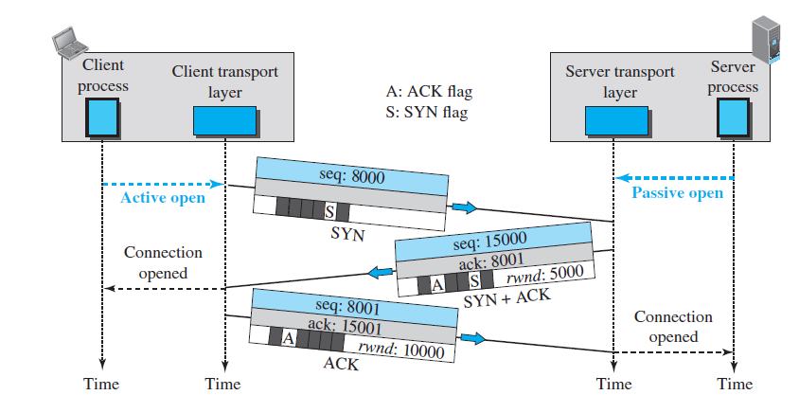
Figure 23.18 Connection establishment using three-way handshaking

Slide 42
Note
A SYN segment cannot carry data, but it consumes one sequence number.

Slide 43
Note
A SYN + ACK segment cannot
carry data, but does consume one
sequence number.

Slide 44
Note
An ACK segment, if carrying no data, consumes no sequence number.

Slide 45
Syn flooding attack
Simultaneous open

Slide 46
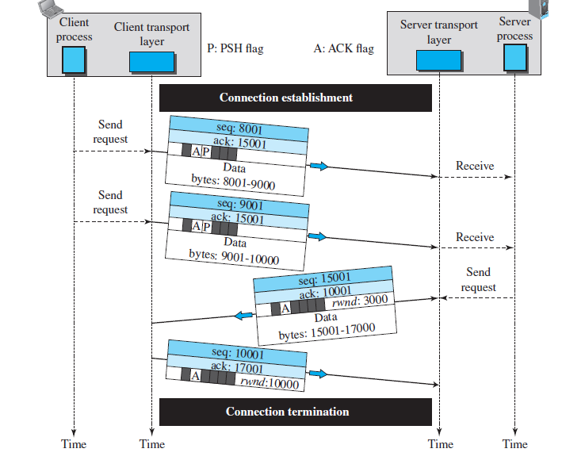
Figure 23.19 Data transfer

Slide 47
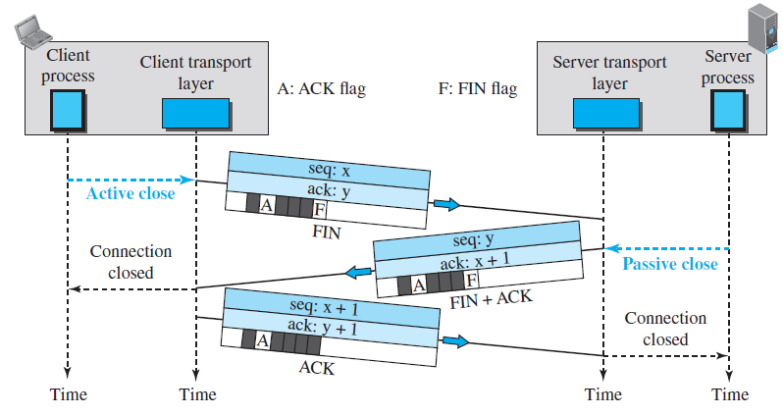
Figure 23.20 Connection termination using three-way handshaking

Slide 48
Note
The FIN segment consumes one sequence number if it does
not carry data.

Slide 49
Note
The FIN + ACK segment consumes
one sequence number if it
does not carry data.

Slide 50
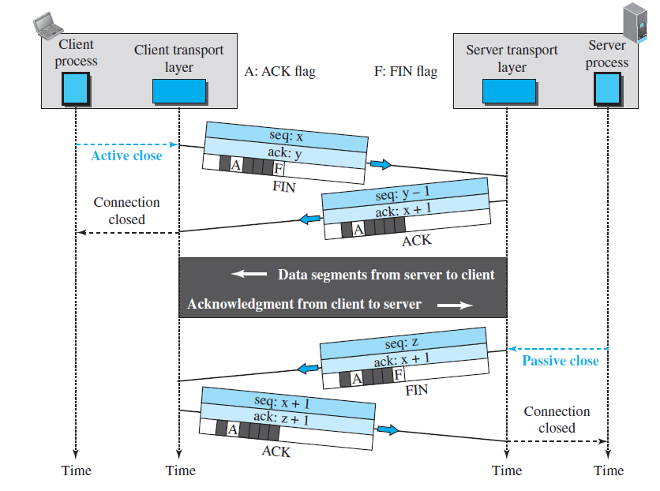
Figure 23.21 Half-close

